Slide 1
Market Insight of Yamazaki Whiskey
Reported by Cassiel Huo

Slide 2
Table of contents
Introduction
Whiskey market analysis
Yamazaki 12-Year old product analysis
Yamazaki 18 & 25-Year old product analysis
Recommendation

Slide 3
Introduction
As produced by Japanese first malt whiskey distillery, The Yamazaki distillery, Yamazaki whiskey is one of the high-quality single malt whiskey around the world.
Distinguished from traditional Scotch Whiskey, during the process of fermentation, Yamazaki whisky used a special Japanese oak barrel in order to introduce gores flowers incense and spices.
In the 1990s, the popularity of Yamazaki whisky grew and new expressions were introduced.
Yamazaki whiskey is definitely a collective choice. Although the price of one single bottle of Yamazaki is located beyond normal price, since Yamazaki 12, Yamazaki 18 and Yamazaki 25 these three main products won the international awards plenty of times, which allowed an increasing in the number of customers of Yamazaki Whiskey. It is also wealth-worthy of owning Yamazaki whisky as the price of them is predicted to grow in the future time.

Slide 4
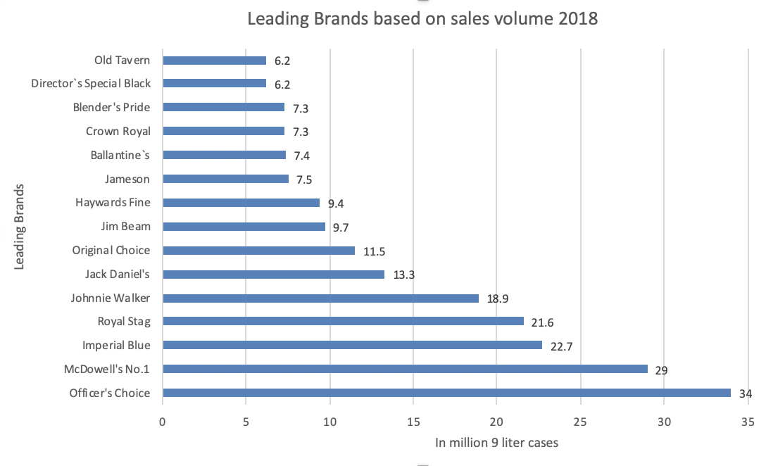
Whiskey market analysis
By the end of 2018, five dominance whisky saling countries are India, Scotland, America, Ireland and Canada.
India has the market share based on sales volume of leading brands as 69%, which is almost 20 times Canada’s 3.44% for the single year of 2018.
The rest Scotland has 26.3% of market share; America has 23%; Ireland 3.54%.

Slide 5
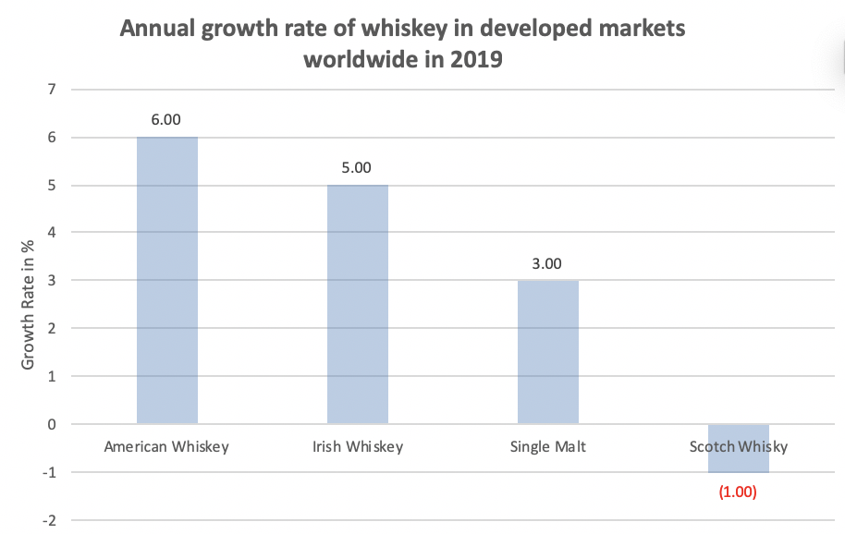
Whiskey market analysis
The global whiskey market size was valued at USD 57.96 billion in 2018 and is projected to register a CAGR of 6.4% over the forecast period
By the end of 2019, single malt whiskey showed increasing trend as +3.0% of the growth rate.
For the recent decade, the global whiskey industry was majorly focused on North America and Europe owing the large customer demand in the U.S., The U.K. and France.
But economically developed Asian-Pacific countries are also likely to attain traction in the years to come.

Slide 6
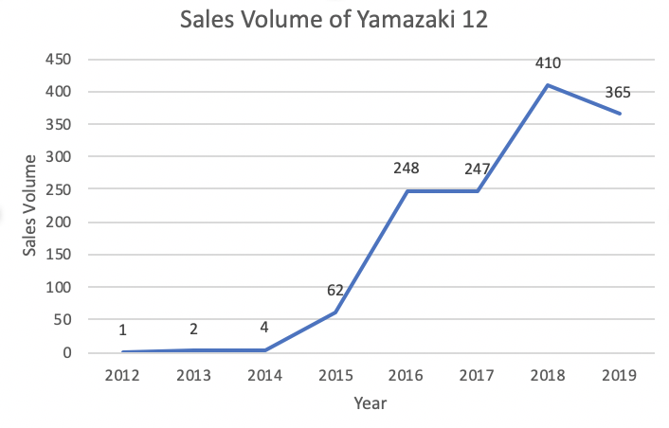
Yamazaki 12-Year old product analysis
The average Hammer price over 2015-2019 of Yamazaki 12-Year old is £98.73, with an increasing trend in both price and sales volume.
With the hammer price doubled over the past 4 years (i.e. from £63.16 in 2015 to £133.41 in 2019), it brings a rising of nearly 6 times from 2015 to 2019 in the quantity of sales.

Slide 7
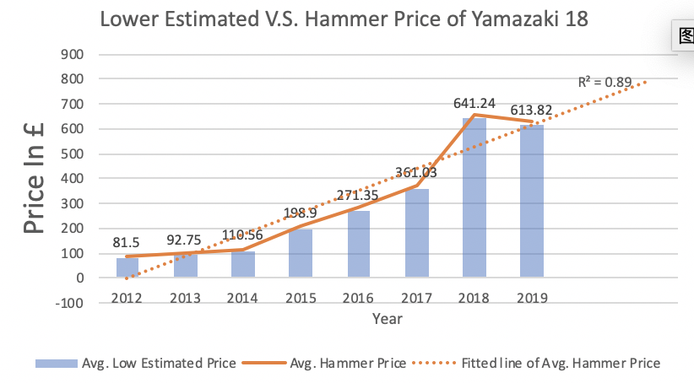
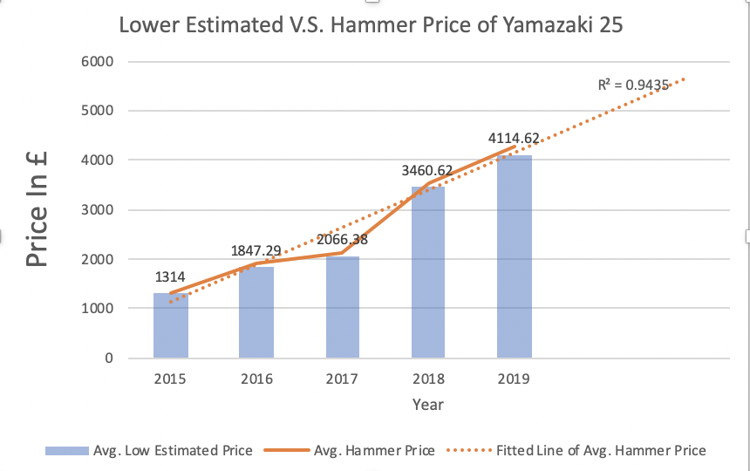
Yamazaki 18 & 25-Year old product analysis
By the end of 2019, Yamazaki 18 & 25 has a sales volume of 1951 bottles (2012-2019) and 2125 bottles respectively. However, both Yamazaki 18 & 25 have experienced decrease in the sales volume of 60% and 55%.
For the same period of time, the price of Yamazaki 25 is 5-6 times higher that Yamazaki 18 with a peak at £4114.62 in 2019, it is also predicted that the price of both products will keep rising in the future years.

Slide 8
Recommandations
Overall, both Yamazaki 12 & 18 & 25 have great auction sale performances the recent 5 years with a total sales of £150,489, £199,764 and £3,551,144 respectively.
As Yamazaki 12 & 18 won the gold awards of International Spirits Challenge in the year of 2018, it is predicted that the price of both 12 & 18 will growing at a steady speed. Thus it is recommended as to do mini-investments on these two main products of Yamazaki whiskey.
By the end of 2019, Yamazaki 25 has already 4 times the price as of 2015, which indicates Yamazaki 25 actually has the most upside potentials. Thus it is recommended as to to investment on Yamazaki 25 for collective purpose.

Slide 9
References
https://www.statista.com/statistics/958347/cagr-whisky-types-developed-market-worldwide/
https://www.statista.com/statistics/259730/leading-whiskey-brands-worldwide-based-on-sales-volume/
https://www.suntory.com/about/award/index.html

